Slide 1
Microsoft CISO Workshop 3 - Identity and Zero Trust User Access
Microsoft Cybersecurity Solutions Group
Video Presentation of this can be found at
https://docs.microsoft.com/en-us/microsoft-365/security/office-365-security/ciso-workshop-module-3
Notes:
© Copyright Microsoft Corporation. All rights reserved. Microsoft, Windows, and other product names are or may be registered trademarks and/or trademarks in the U.S. and/or other countries. The information herein is for informational purposes only and represents the current view of Microsoft Corporation as of the date of this presentation. MICROSOFT MAKES NO WARRANTIES, EXPRESS, IMPLIED OR STATUTORY, AS TO THE INFORMATION IN THIS PRESENTATION.

Slide 2
Microsoft CISO workshop
Lunch
Your strategy
Security management learnings and principles
Kickoff and introduction
Identity and Zero Trust Architecture
Threat protection
(A) Identify-Protect
(B) Detect-Respond-Recover
Typical stakeholders
Identity Security Architects
Identity Architects
Identity Operations Teams
Collaboration/Productivity Lead
Information protection
Joint planning
CISO WORKSHOP OBJECTIVE: Learn how Microsoft can help you achieve your cybersecurity goals
Notes:
Key Takeaway: This is the Threat Protection module of a full day workshop designed for both your organization and Microsoft to learn where Microsoft can help you achieve your cybersecurity goals.
This module will focus the trends, challenges, and recommended strategy for threat protection (including how Microsoft’s capabilities and guidance map into that strategy)

Slide 3
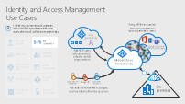
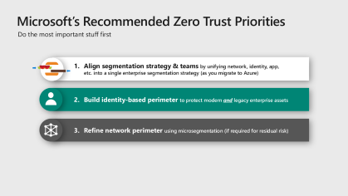
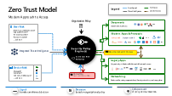
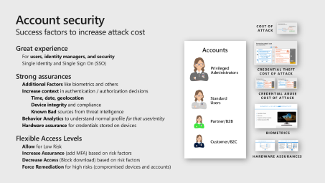
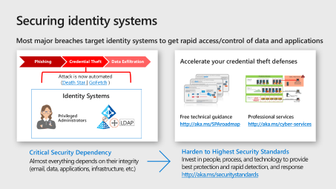
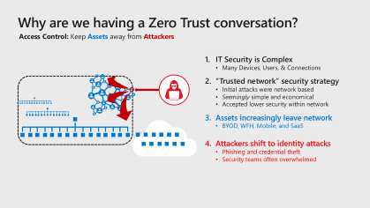
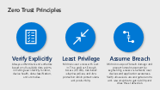
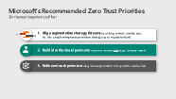
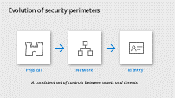
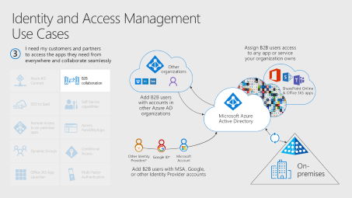
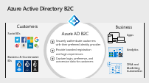
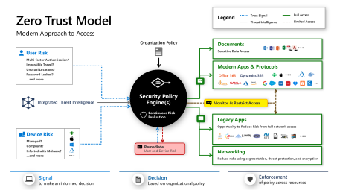
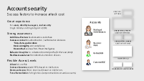
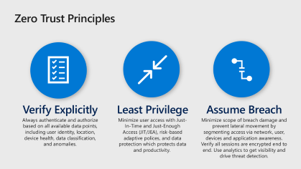
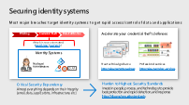
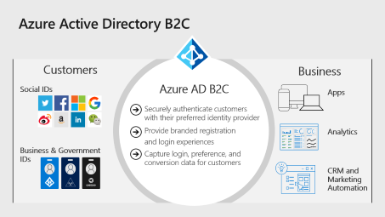
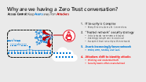
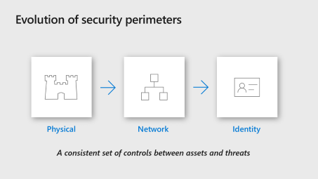
Identity and Zero Trust User Access
Context
Accounts & Passwordless
Zero Trust Architecture
Identity & Zero Trust History
Account Security & Going Passwordless
ZT Access Control Reference Architecture
Building an Identity Perimeter
Identity Systems
3rd party Account RISK
Zero Trust Definition & Models
Identity System Security
Partner Access to Corporate Resources (B2B)
Customer Identities (B2C)
Strategy & Priorities
Notes:
Key Takeaway: This is the module layout.
This slide uses the PowerPoint zoom feature, you can present it and click on each section to skip to it

Slide 4
Evolution of IT, threats, and Microsoft Identity security
MICROSOFT IDENTITY APPROACH
Windows NT Domains
Enterprise Active Directory
Smartcard Authentication
Azure Active Directory
Zero Trust Access Control (Conditional Access)
Passwordless Authentication
Widespread Password Weakness and Re-use
Credential Theft Attacks
Mass Password Compromises
IDENTITY AND ACCESS TRENDS
Local Identities
Enterprise Single Sign On + 2 factor authentication
Hybrid and Federated Cloud Identity
INFORMATION TECHNOLOGY
Mainframes + PCs
+ Datacenters + Mobile Devices
+ Cloud + Internet of Things (IoT)
Notes:
Key Takeaway: Microsoft is driving an identity driven security approach to help our customers more easily protect key assets and establish a defensible identity based security perimeter
As the IT world transitioned from Mainframes and PCs into Datacenters and Mobile devices, Microsoft saw (and help drive) the consolidation of identities and introduction of 2 factor authentication to combat password weakness and re-use.
CLICK 1
In the age of cloud and internet of things (IoT), enterprise identity and access management is now incorporating hybrid and federated cloud identities to manage access to this new generation of resources.
CLICK 2
Microsoft’s identity and access approach started out with Windows NT Domains to consolidate on-premises accounts and continued into Enterprise Active Directory. We natively integrated smartcard authentication and support for many 3rd party multi-factor authentication (MFA) and password filter approaches to help address risks from widespread password weakness and re-use.
CLICK 3
While we saw some adoption of MFA, passwords continued to persist as the norm for enterprise and internet authentication. Additionally, we saw the rise of credential theft attacks after the publication of high-quality attack tools that ‘democratized’ these attacks (including pass the hash toolkit, Windows Credential Editor, and Mimikatz) and massive password database compromises.
To help our customers manage these risks and safely embrace modern technology, we launched Azure Active Directory to provide unified identity management in the cloud age and integrated biometric and phone authentication to increase both security and productivity.
Additionally, we integrated cutting edge TPM hardware assurances into Windows to protect these new credentials (Windows Hello) and legacy NTLM/Kerberos Credentials (Credential Guard)

Slide 5
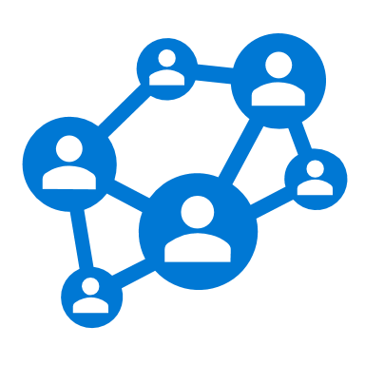




Why are we having a Zero Trust conversation?
Access Control: Keep Assets away from Attackers
IT Security is Complex
Many Devices, Users, & Connections
“Trusted network” security strategy
Initial attacks were network based
Seemingly simple and economical
Accepted lower security within network
Assets increasingly leave network
BYOD, WFH, Mobile, and SaaS
Attackers shift to identity attacks
Phishing and credential theft
Security teams often overwhelmed
Notes:
Key Takeaway – Zero trust represents a generational shift in security strategy that reflects major changes in assets being protected and evolution of attack techniques.
See video at this site for more information/context - https://docs.microsoft.com/en-us/microsoft-365/security/office-365-security/ciso-workshop-module-3#part-1-identity-and-zero-trust-history-933

Slide 6

This “Zero Trust” idea has been evolving for a while
2004 Jericho Forum Formally Established
2014 Microsoft Advocates “Assume Breach”
2016 Conditional Access Released
Ongoing
Passwordless Initiative
~2004 Network Access Control (NAC) Architectures
2010 Forrester coins “Zero Trust” Term
2014 BeyondCorp Published
2017
Slow mainstream adoption for both network identity models:
Network – Expensive and challenging to implement
Google’s BeyondTrust success is rarely replicated
Identity – Natural resistance to big changes
Security has a deep history/affinity with networking
Notes:
Key Takeaway – The zero trust idea has been evolving for a while, but saw relatively slow mainstream adoption until recently
See video at this site for more information/context - https://docs.microsoft.com/en-us/microsoft-365/security/office-365-security/ciso-workshop-module-3#part-1-identity-and-zero-trust-history-933

Slide 7
Trends and challenges
****
Attackers using identity to bypass network controls
Phishing allow attackers to impersonate valid user Identities
Credential theft allows attackers to expand access by impersonating identities
Passwords aren’t enough to protect identities
Single factor authentication (Passwords) without context isn’t enough assurance
Attacks on credentials circumvent software assurances (without hardware isolation)
Identities being used outside network
Cloud, Mobile, and IoT assets are frequently beyond reach of enterprise firewalls
Identity and Access controls are inconsistent on different cloud services and devices
Notes:
Key Takeaway: The everchanging threat environment is challenging, but there are ways to be more effective using the right blend of modern identity security technology, strategy, and expertise
Attacks are bypassing network controls
Attackers are reliably penetrating traditional security boundaries using phishing attacks and credential thefts, both of which are effectively operating at the identity layer by impersonating existing users and running code as their account.
CLICK 1
Password breaches and credential theft on the rise
Credential theft (in various forms), Password spray (attempting common passwords against many accounts), and breach replay (attempting username/passwords from a previous breach) are prolific elements of current attacks, necessitating new approaches to validate user identities and protect them from theft/tampering on the devices where they are used.
CLICK 2
Devices & services expanding beyond network control
As the scope of enterprise assets grows into cloud and internet of things, the ability to place network controls between your assets and the threats to them is fast disappearing.
CLICK 3
Requires Blend of Human Expertise and Technology
Signals are growing far faster than humans can possibly process them manually (as an example, the systems that collectively comprise Microsoft’s Intelligent Security Graph take in about 6.5 trillion signals per day). Defenders will not be successful in detecting and responding to attacks with a purely manual process based on human expertise, nor will they succeed against human adversaries with a completely automated process that excludes human judgement. Success will require blending human expertise and automation technologies like machine learning and orchestration, and techniques like user and entity behavioral analytics (UEBA) to achieve the best outcome. Without this combination, you can’t sort out the signal (real incidents) from the noise (false positives).
Additional Commentary
As an illustration, Microsoft’s IT department is driving a digital transformation and
Aspires to let any employee to do their work and access their resources on any device (including managing the security implications of that)
Measures the user experience vs. the specific technology of any security change (e.g. How many people would be affected by a policy like blocking unknown IPs or TOR IPs from authenticating?)

Slide 8



Zero Trust Principles
Verify Explicitly
Least Privilege
Assume Breach
Always authenticate and authorize based on all available data points, including user identity, location, device health, data classification, and anomalies.
Minimize user access with Just-In-Time and Just-Enough Access (JIT/JEA), risk-based adaptive polices, and data protection which protects data and productivity.
Minimize scope of breach damage and prevent lateral movement by segmenting access via network, user, devices and application awareness. Verify all sessions are encrypted end to end. Use analytics to get visibility and drive threat detection.
Notes:
Key Takeaway – These are the principles for zero trust
See video at this site for more information/context - https://docs.microsoft.com/en-us/microsoft-365/security/office-365-security/ciso-workshop-module-3#part-2-zero-trust-definition-and-models-1537

Slide 9

Zero Trust Access Control Strategy
Never Trust. Always verify.
Increase Assurance
Remediate Risk
Allow full access
Allow limited Access
Block access
Signal
Decision
Enforcement
to make an informed decision
Device Risk
Device Management
Threat Detection
and more…
User Risk
Multi-factor Authentication
Behavior Analytics
and more…
based on organization’s policy
Apply to inbound requests
Re-evaluate during session
of policy across resources
Modern Applications
SaaS Applications
Legacy Applications
And more…
Notes:
Key Takeaway – These are the key basic components of a Zero Trust Strategy
See video at this site for more information/context - https://docs.microsoft.com/en-us/microsoft-365/security/office-365-security/ciso-workshop-module-3#part-2-zero-trust-definition-and-models-1537

Slide 10
Zero Trust Access Control Paradigms
Network
Identity
Control Plane
Apply Zero Trust Policy to network connections
Apply Zero Trust Policy to access requests
Industry Proponents
Network Security Vendors
Identity Vendors
Microsegmentation enhances existing network perimeter by shrinking “trusted network” to each server / IP address.
Dual Perimeter – Adds an identity perimeter where “inside” is defined by authentication and authorization. Coexists with network perimeter
Overall Effect
Limited to networks controlled by customer. Doesn’t protect modern SaaS and PaaS assets. Microsegmentation approach varies by vendor
Applies to all assets –
Natively protects modern cloud assets
Protects legacy intranet assets via proxy
Applicability/Scope
Scope of assets where zero trust is enforced
Threat Intelligence signal Integration
Integration of Behavior Analytics (UEBA) risk signal
Use of ML across large datasets decisions
Microsoft focuses on protecting modern and legacy assets as well as integration of ML, UEBA, and massive diverse threat intelligence
Differentiation
Common Components
Evaluate trust signals for Devices & User Identities with per application policy
Notes:
Key Takeaway – This is a comparison of Zero Trust approaches
See video at this site for more information/context - https://docs.microsoft.com/en-us/microsoft-365/security/office-365-security/ciso-workshop-module-3#part-2-zero-trust-definition-and-models-1537

Slide 11
Microsoft’s Recommended Zero Trust Priorities
Do the most important stuff first
Align segmentation strategy & teams by unifying network, identity, app, etc. into a single enterprise segmentation strategy (as you migrate to Azure)
Build identity-based perimeter to protect modern and legacy enterprise assets
Refine network perimeter using microsegmentation (if required for residual risk)
Notes:
Key Takeaway – This is Microsoft’s recommendation for strategically prioritizing zero trust activities
See video at this site for more information/context - https://docs.microsoft.com/en-us/microsoft-365/security/office-365-security/ciso-workshop-module-3#part-3-strategy-and-priorities-954

Slide 12
Integrating Zero Trust with Strategic Initiatives
Closely related to other initiatives
Zero Trust Identity Architecture Establish Identity Perimeter with Conditional Access to Resources
SOC Modernization Shift Tooling and Processes to Endpoint, Identity, and Application Layers
Secure Administration Infrastructure/Datacenter access for admins
Network Transformation
Internet-only clients / Firewalls for Datacenters onl
Evaluate Microsegmentation
Resource Modernization Enable ZT Access to Legacy Apps
Notes:
Key Takeaway – This is a view of how zero trust activities integrate with other strategic security activities
See video at this site for more information/context - https://docs.microsoft.com/en-us/microsoft-365/security/office-365-security/ciso-workshop-module-3#part-3-strategy-and-priorities-954

Slide 13

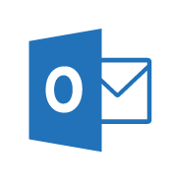
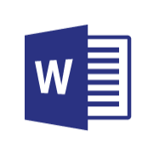
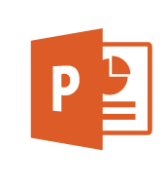
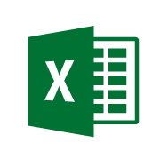




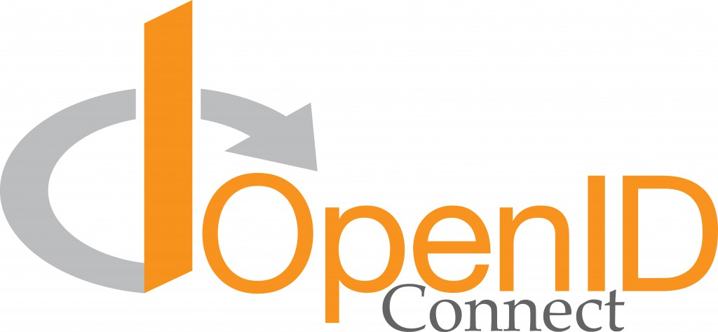







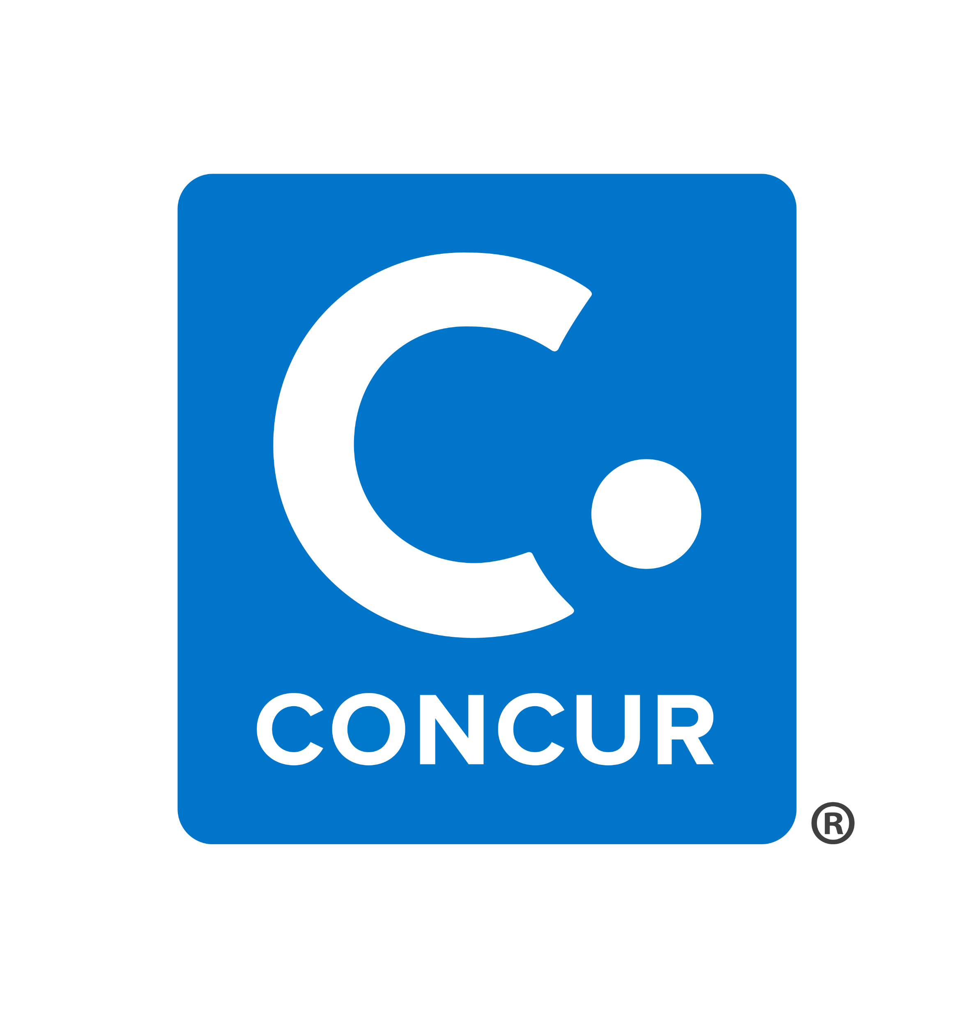
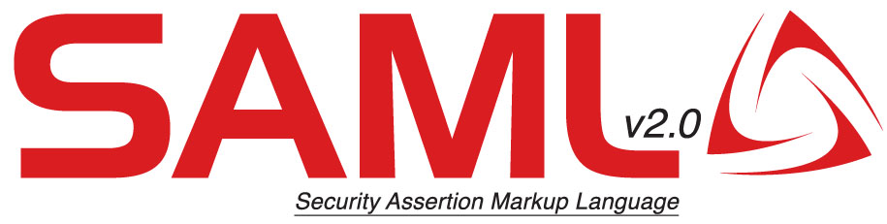




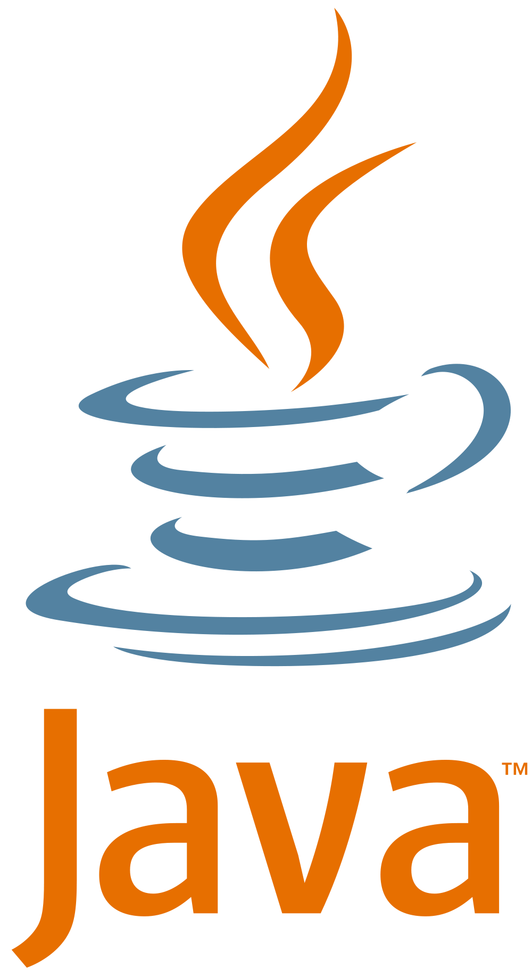

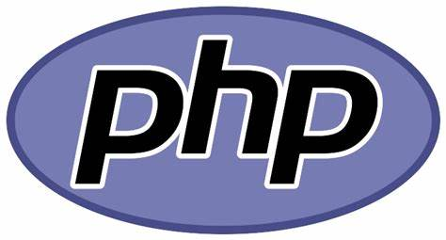
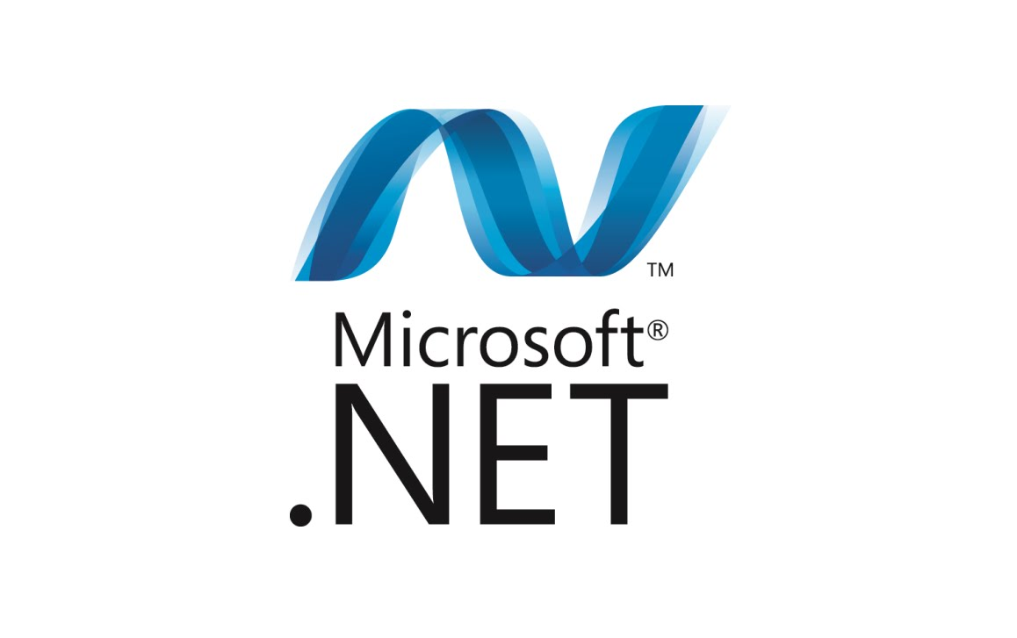

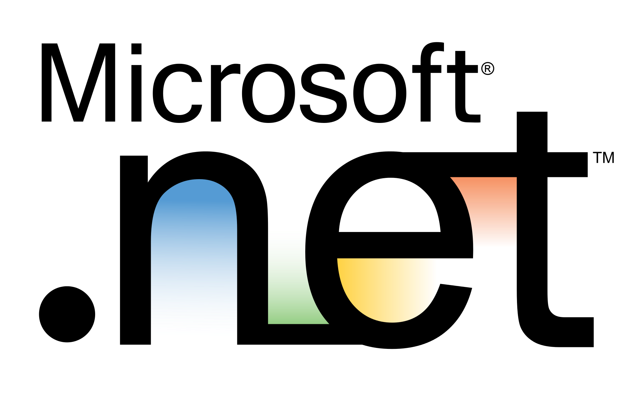
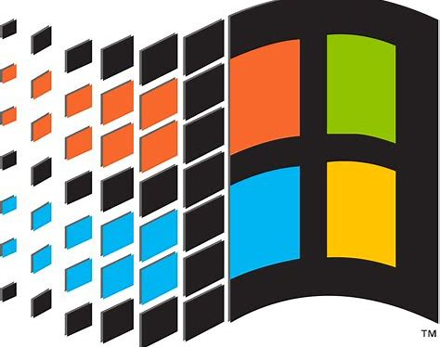
Zero Trust Model
Legend
Trust Signal
Full Access
Threat Intelligence
Limited Access
Modern Approach to Access
Organization Policy
Documents
Sensitive Data Access
User Risk
Multi-factor Authentication?
Impossible Travel?
Unusual Locations?
Password Leaked?
…and more
Modern Apps & Protocols
Security Policy Engine(s)
Office 365
Dynamics 365
Integrated Threat Intelligence
Monitor & Restrict Access
Continuous Risk Evaluation
Legacy Apps
Opportunity to Reduce Risk from full network access
Device Risk
Managed?
Compliant?
Infected with Malware?
…and more
{LDAP}
Remediate User and Device Risk
Networking
Reduce risks using segmentation, threat protection, and encryption
Signal to make an informed decision
Decision based on organizational policy
Enforcement of policy across resources
Notes:
Key Takeaway – This is an overview of the Zero Trust model
See video at this site for more information/context – https://docs.microsoft.com/en-us/microsoft-365/security/office-365-security/ciso-workshop-module-3#part-5-zero-trust-user-access-reference-architecture-842

Slide 14


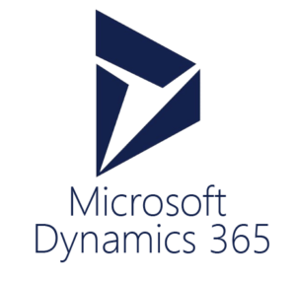





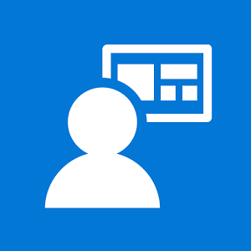
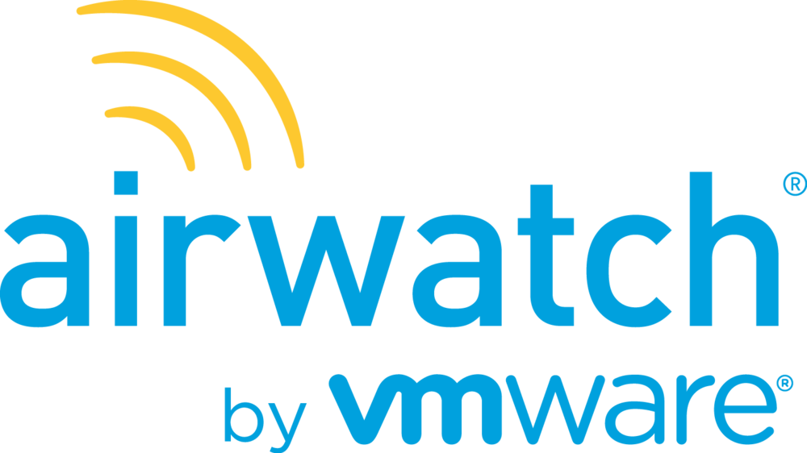


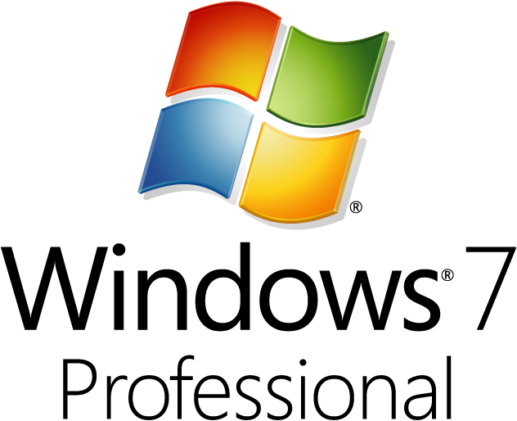

Zero Trust User Access
Legend
Full access
Limited access
Risk Mitigation
Remediation Path
Conditional Access to Resources
Policy is evaluated when
Initial Access Request
Change in posture (AADIP signal)
Microsoft Applications
User Threat/ Risk Signals
Azure AD Identity Protection
Leaked cred protection
Behavioral Analytics
Lower Access
Restricted session
Office 365
Dynamics 365
Azure ATP
Azure Resource Manager
Cloud Infrastructure
Organization Policy
Cloud App Security
User/Session Risk
Azure Portal
Linux Login
User risk
Conditional Access
Modern Applications
Hello for Business
Increase Trust by requesting MFA
Monitor & Restrict Access
Azure MFA
Multi-Factor Authentication
Cloud App Security
Conditional Access App Control
SaaS Applications
Intelligent Security Graph (ISG)
6.5 Trillion Signals/Day
Azure Active Directory (Azure AD)
IsCompliant
Azure AD App Proxy
Azure AD B2B
Legacy Apps (Secure VPN Replacement )
Partner MDM
Microsoft Intune
{LDAP}
Remediate Leaked Credential (Requires MFA)
Azure Information Protection (AIP)
Microsoft Defender ATP
Device Threat/ Risk Signals
Documents
Device risk
Azure AD Self Service Password Reset (SSPR)
Microsoft Intune (MAM functionality)
Mobile Apps
Active Directory
IsManaged
Approved Apps
Signal to make an informed decision
Decision based on organizational policy
Enforcement of policy across resources
Notes:
Key Takeaway – This is an overview of the Zero Trust model being applied to user access to resources via Microsoft’s Conditional Access (built into Azure Active Directory)
See video at this site for more information/context – https://docs.microsoft.com/en-us/microsoft-365/security/office-365-security/ciso-workshop-module-3#part-5-zero-trust-user-access-reference-architecture-842

Slide 15








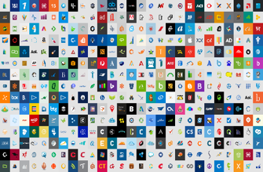

Azure AD conditional access (Zero Trust)
Azure AD
ADFS
Conditions
Controls
MSA
40TB
Google ID
Employee & Partner Users and Roles
Allow/block
access
Microsoft Cloud
Android
Session Risk
iOS
Trusted & Compliant Devices
Machine learning
3
MacOS
Limited
access
Microsoft Cloud App Security
Windows
Windows Defender ATP
Require
MFA
Real time Evaluation
Engine
Cloud SaaS apps
Force
password
reset
Geo-location
Physical & Virtual Location
******
Corporate Network
Policies
Effective policy
Client apps & Auth Method
Block legacy authentication
Browser apps
Client apps
On-premises & web apps
Notes:
Expanded view of all the conditions that are taken into account for access and the controls that you have based on the risk.
Our 40 TB of data from all the conditions, integrated EMS/M365 apps, and our security intelligence network are analyzed in real-time to determine the right policy.
Example: If an ADFS user signs in on a Windows machine with Windows Defender ATP we can take into account the health of the account and the device, as well as their location and if they are on the corporate network and what type of app they are trying to access. If they are on the corporate network in their normal office then the data produces a low risk score. The effective policy is to all access to the app. If, however, the person was logging in from a location across the world (in a short amount of time – impossible travel) and/or the Windows Defender ATP finds that the machine has been infected, the access can be blocked. If the user login and device are healthy, but it was a location they haven’t signed in from before (on a trip or other computer) then the user could be prompted with MFA or have limited access to certain applications.

Slide 16
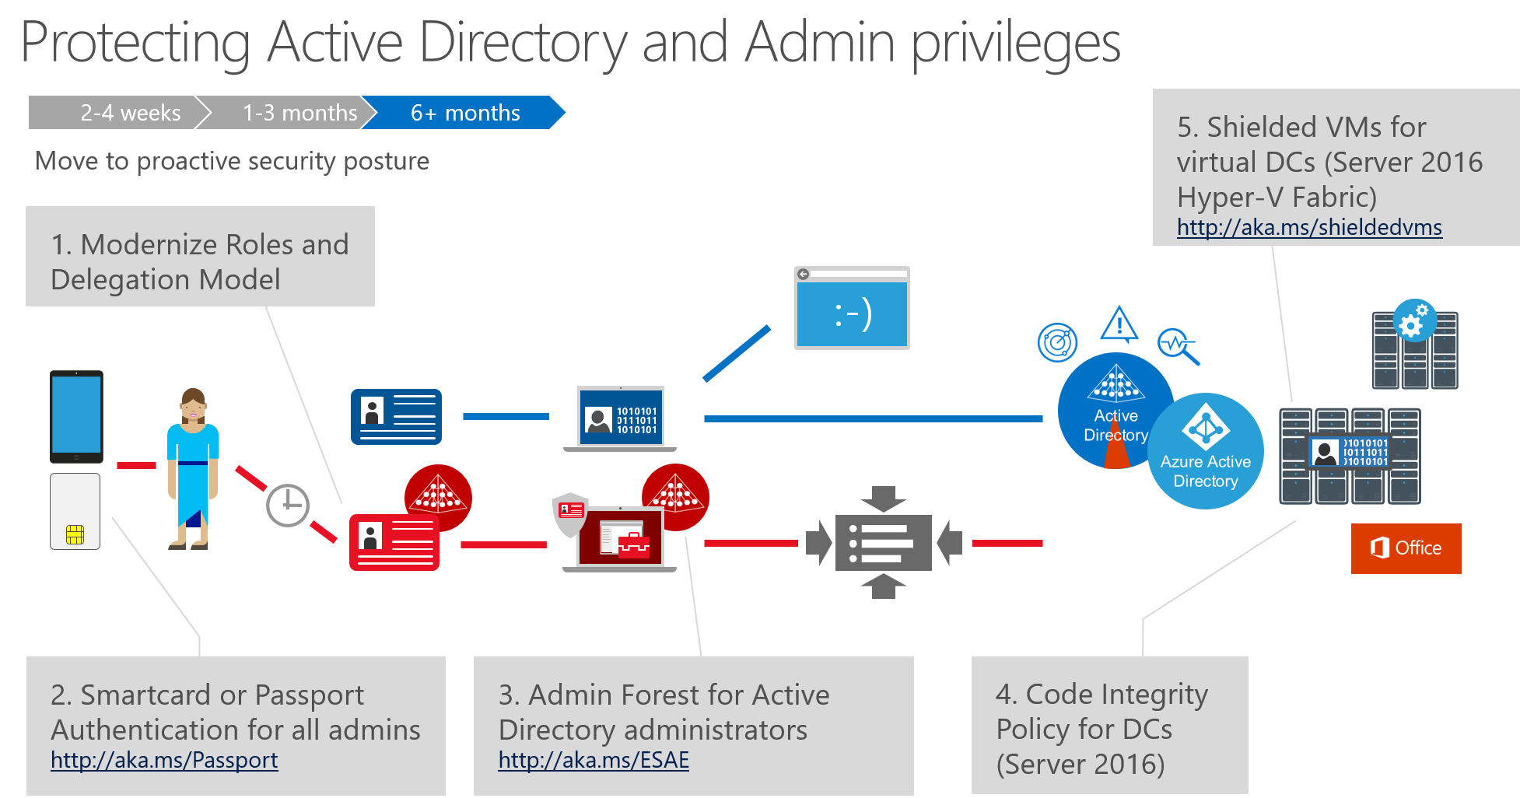
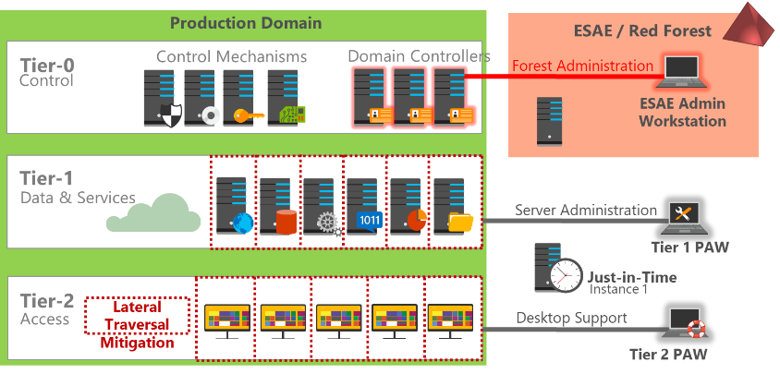
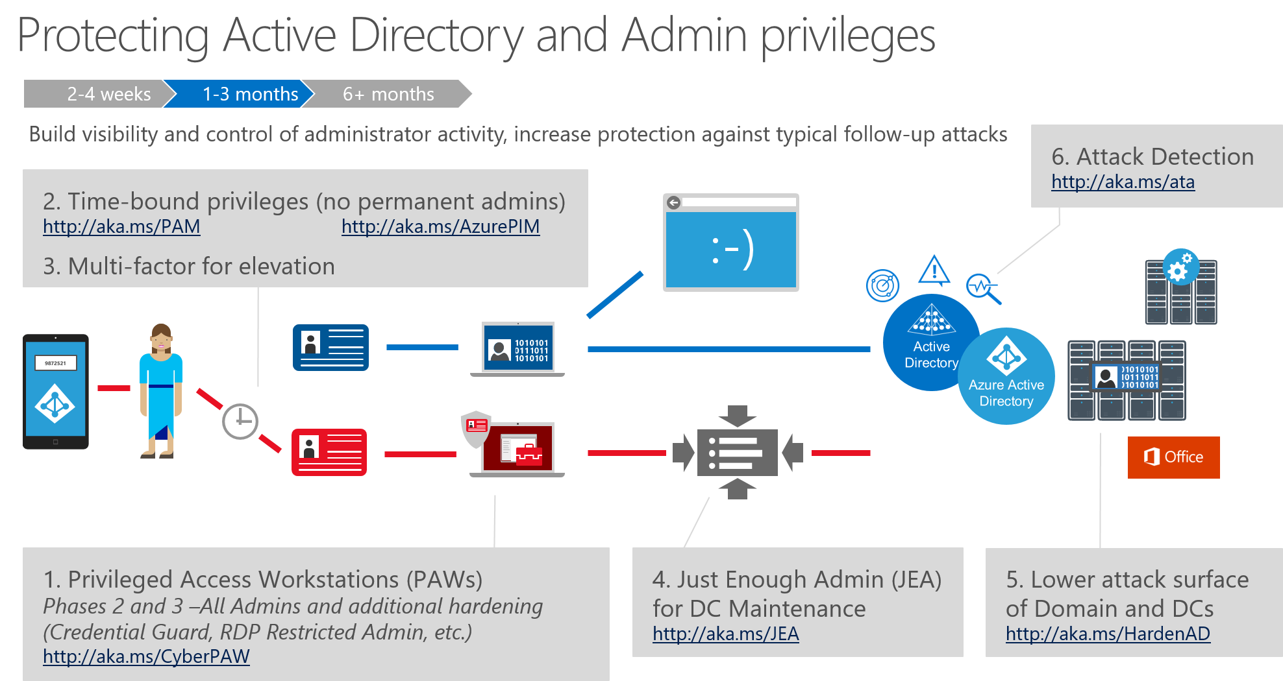
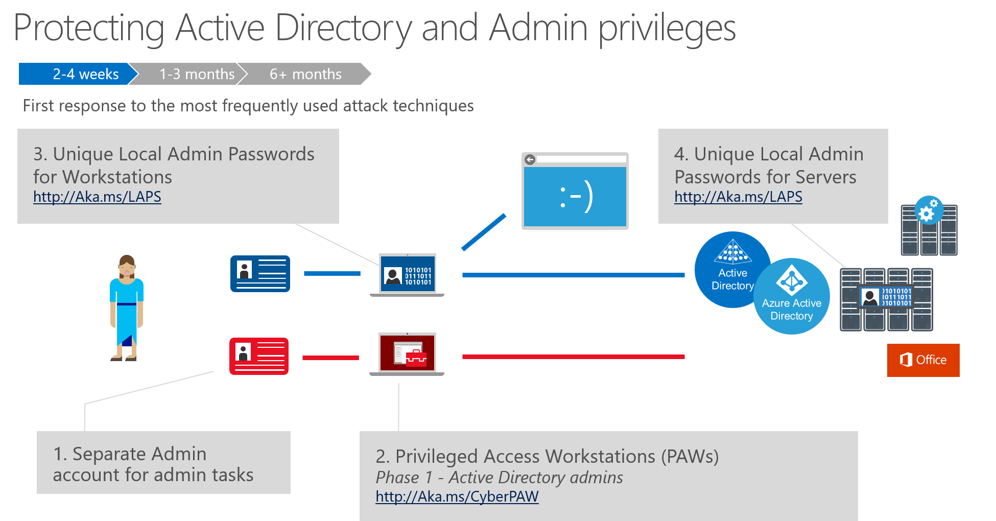
Securing identity systems
Most major breaches target identity systems to get rapid access/control of data and applications
Phishing
Credential Theft
Data Exfiltration
Accelerate your credential theft defenses
Attack is now automated (Death Star | GoFetch )
Identity Systems
Privileged
Administrators
Free technical guidance
http://aka.ms/SPAroadmap
Professional services
http://aka.ms/cyber-services
LDAP
Critical Security Dependency
Almost everything depends on their integrity (email, data, applications, infrastructure, etc.)
Harden to Highest Security Standards
Invest in people, process, and technology to provide best protection and rapid detection, and response http://aka.ms/securitystandards
Notes:
Key Takeaway: Identity systems are a critical security dependency for nearly all assets in your environment.
Most or all security assurances depend on the integrity of your identity systems and the accounts in them.
CLICK 1
Attackers are aware of the power of compromising identity systems and frequently target them in the course of a multi stage attack. This is a shortcut for the attackers to rapidly control any or all assets in your environment.
CLICK 2
Because of this, you should secure your identity systems at the highest standards. Microsoft has published our recommended security standards as well as prescriptive technical guidance on how to quickly meet them. Microsoft also offers professional services to help you accelerate meeting these standards for your identity system security. This can be found at http://aka.ms/sparoadmap

Slide 17
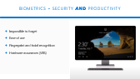
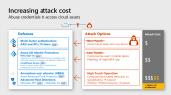
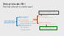
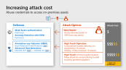
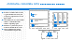
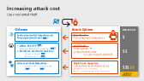
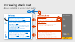
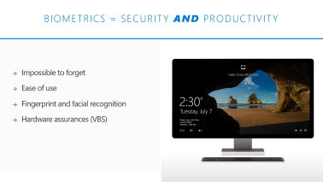
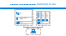
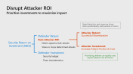



Account security Success factors to increase attack cost
Cost of Attack
Great experience
For users, identity managers, and security
Single Identity and Single Sign On (SSO)
Strong assurances
Additional Factors like biometrics and others
Increase context in authentication / authorization decisions
Time, date, geolocation
Device integrity and compliance
Known Bad sources from threat intelligence
Behavior Analytics to understand normal profile for that user/entity
Hardware assurance for credentials stored on devices
Flexible Access Levels
Allow for Low Risk
Increase Assurance (add MFA) based on risk factors
Decrease Access (Block download) based on risk factors
Force Remediation for high risks (compromised devices and accounts)
Accounts
Privileged
Administrators
Credential Theft
Cost of Attack
Credential Abuse
Cost of Attack
Standard Users
Partner/B2B
Biometrics
Customer/B2C
Hardware Assurances
Notes:
Key Takeaway: These are recommended success criteria for securing accounts: Great experience, Strong Assurances, and Flexible Access Levels
First, you need a great experience that allows each role to effectively do their job (and discourage them from working around security controls and violating policy)
CLICK 1
Next, you need strong security assurances is for those accounts. Simply possessing the password is not sufficient in today’s world. You need to have contacts on the authentication to identify
Did we get enough validation of the user (e.g. biometrics, coming from a known good device, etc.)
Is it part of the normal pattern for this user?
Is there a known bad component to this? (e.g. coming from known bad IP address)
Additionally, these account credentials need to be protected as they are used and stored on devices using the strongest protection of TPM hardware assurances.
CLICK 2
Last, we need to be able to establish and monitor and enforce policy in a flexible and nuanced way. Organizations need the ability to allow low risk scenarios, block access in high risk situations, remediate risks automatically where possible, and provide other flexible risk mitigations that preserve productivity while minimizing risk.

Slide 18
Eliminate Passwords through strong and multifactor authentication
Approach to a Password-less World
Today
1
2
3
4
Develop and Deploy password-replacement offerings
Reduce user-visible password surface area
Transition users to using strong authentication instead of passwords
Eliminate passwords from identity directory
Achieve End-user Promise
Achieve Security Promise
Windows Hello for Business
Available on all Windows 10 Machines today with improvements coming in RS4 and RS5
FIDO Microsoft + Third Party
Microsoft Authenticator
Available today across all mobile platforms, integral in corporate bootstrapping of MFA
Notes:
Key Takeaway: This is a phased approach for an enterprise to become fully passwordless based on Microsoft’s journey in our corporate IT environment
https://cloudblogs.microsoft.com/microsoftsecure/2018/05/01/building-a-world-without-passwords/

Slide 19
Evolution of security perimeters
Physical
Network
Identity
A consistent set of controls between assets and threats
Notes:
Key Takeaway: The need for a security perimeter has stayed consistent, but its form has evolved over time
We started off with physical perimeters to protect physical assets using walls, cameras, and guards.
CLICK 1
As we network computers together and saw attacks come in, we realized we needed to adapt these concepts to protect computers on a network.
CLICK 2
As we now progress beyond corporate controlled networks to enterprise is that span the Internet, we now need a new type of security perimeter. The common controls we have available are all based on identity and access-- authentication and authorization controls.
Let’s take a deeper look into this evolution

Slide 20
Modernizing the security perimeter
Persistent
Network protects against classic attacks…
…but bypassed reliably with
Phishing
Credential theft
Data moving out of the network
Critical to build modern security perimeter based on Identity
Identity and Access Management Strong Authentication + Monitoring and enforcement of policies
Strength from Hardware & Intelligence– Auth & Access should consider device status, compromised credentials, & other threat intelligence
?
Threats
Shadow IT
Identity Perimeter
Office 365
Approved Cloud Services
Resources
Devices
Network Perimeter
Notes:
Key Takeaway: Defender need to transition to using an identity security perimeter as our primary defense strategy
CLICK 1
The first thing to note is that the network security perimeters we built still work against the attacks they were designed to repel. This is quickly confirmed by anyone exposes an unpatched operating system or application to the direct internet without a firewall.
CLICK 2
Unfortunately attackers have also developed a new generation of techniques that include phishing and credential theft. These techniques allow attackers to reliably penetrate the network security perimeter and navigate around behind it.
CLICK 3
Additionally, newer technologies to increase productivity are causing data to move outside the corporate network onto managed and unmanaged devices, cloud services (both sanctioned/managed and unauthorized/Shadow IT applications). The trustworthiness of these devices and services are not defined by which IP subnet they are hosted on, so we need to manage the identities of these users, devices, services, and data.
CLICK 4
Both of these trends diminish the effectiveness of the network as the sole security perimeter. We now need to establish an identity based perimeter so we can draw a line (of consistent security controls) between our assets and the threats to them.

Slide 21


VISIBILITY AND CONTROL AT THE PERIMETER
Intrusion Detection/Prevention
Forward/Reverse Proxy
Intranet Resources
Firewall
Actions:
Allow
Block
Source: IP Address/Port
Destination: IP Address/Port
Signatures
Analytics
Allow List
Authentication
User
Device
High
Medium
Low
Actions:
Allow
Allow Restricted
Require MFA
Block
Force Remediation
Role
Group
Device
Config
Location
Last Sign-in
Health/Integrity
Client
Config
Last seen
Conditional access risk
Notes:
Key Takeaway: This is a comparison of the visibility and control you get with classic network perimeters vs a modern identity perimeter (based on Azure Active Directory Conditional Access)
A network perimeter is composed of several functions (often combined into the same appliance) that uses data available from the network traffic to make a decision on whether to allow or block a connection. While this provides security visibility and control against some attacks, it has several significant limitations including:
Scope is limited to resources hosted on a controlled network such as an intranet/extranet
Visibility is limited to what is available on the network, which is often encrypted and frequently lacks important context on application function, user identity, data sensitivity, and other factors.
Control is limited to allow and block, which doesn’t allow for managing the user experience and providing self service corrections, exception management, etc.
CLICK 1
In contrast, an identity perimeter is aware of the user, device, and a number of attributes about each of them including the user's role, whether they logged on with MFA, when and where the device was last seen, the security health of the device, and more.
The conditional access engine uses this information to calculate the relative risk of the operation as high, medium or low.
The actions available include allow and block as well as
Allow Restricted – Users may be allowed to authenticate, but only granted limited access (e.g. a user would be granted only online access to document in SharePoint online vs. being allowed to download)
Require MFA - For authentication attempts with a medium risk (such as authentications from an unexpected time/geography), conditional access can require additional proof of identity before granting access (where this wouldn’t happen within their normal time/geography)
Force Remediation – For high risk scenarios such as a known compromised password or computer, conditional access can force the issue to be remediated (e.g. force the user to change a password that has been leaked, requiring defender to remediate the device
Network based perimeters provided needed controls for legacy workloads and PaaS components where the workload is under the control of the IT department (e.g. web applications), but protecting data and protecting newer asset types like Software as a Service (SaaS) requires and identity perimeter to provide the needed visibility and control.

Slide 22

Conditional Access Example
User
Device
High
Office resource
Medium
Low
Block access
Force threat remediation
Sensitivity: Medium
Role: Sales Account Representative
Group: London Users
Device: Windows
Config: Corp Proxy
Location: London, UK
Last Sign-in: 5 hrs ago
Health: Device compromised
Client: Browser
Config: Anonymous
Last seen: Asia
Conditional access risk
For insights into password spray and other modern attack patterns, see
Your Pa$$word doesn't matter
Malicious activity detected on device
Anonymous IP
Unfamiliar sign-in location for this user
Notes:
Key Takeaway: This is an example of conditional access enforcing policy on an authentication attempt
In this example, a user is logging in with a device and attempting to access an internal file in Office 365 with a medium sensitivity
CLICK 1
The user provides valid credentials and the user/device information checks out (so far), so the conditional risk level would be low.
CLICK 2
As other factors are considered in the authentication decision, conditional access finds risk factors that would set risk to
Medium
An anonymous IP as the connection is coming in over the Tor network
The device was last seen in an unfamiliar sign in location
High
Defender ATP has indicated that this device has been compromised
Because of this, the conditional access engine blocks the authentication attempt and forces threat remediation (through Defender ATP)
Reference
https://techcommunity.microsoft.com/t5/Azure-Active-Directory-Identity/Your-Pa-word-doesn-t-matter/ba-p/731984

Slide 23











Identity and Access Management Use Cases
3
I need my customers and partners to access the apps they need from everywhere and collaborate seamlessly
Assign B2B users access to any app or service your organization owns
Other organizations
Azure AD Connect
B2B collaboration
SharePoint Online & Office 365 apps
SSO to SaaS
Self-Service capabilities
Add B2B users with accounts in other Azure AD organizations
Remote Access to on-premises apps
Access Panel/MyApps
Microsoft Azure
Active Directory
Dynamic Groups
Conditional Access
Other Identity
Providers*
Google ID*
Microsoft Account
On- premises
Office 365 App Launcher
Multi-Factor Authentication
Add B2B users with MSA, Google, or other Identity Provider accounts
Notes:
Key Takeaway: An organization can reduce their risk by adopting technology like Azure B2B
By moving partner accounts from enterprise directories to a B2B solution, you are effectively lowering their access to your environment to the least privilege required.

Slide 24









Azure Active Directory B2C
Azure AD B2C
Customers
Business
Social IDs
Apps
Securely authenticate customers with their preferred identity provider
Provide branded registration
and login experiences
Analytics
Business & Government IDs
Capture login, preference, and conversion data for customers
CRM and Marketing Automation
contoso
Notes:
Key Takeaway: An organization can reduce their risk by adopting technology like Azure B2C
By moving customer/citizen accounts from enterprise directories to a B2B solution, you are effectively lowering their access to your environment to the least privilege required. Additionally B2C solutions like this capability also offer compelling capabilities to gain insights into your customers that can benefit the business/mission of the organization.

Slide 25
Questions?

Slide 27
Reference

Slide 28
Additional Resources
Azure AD and ADFS best practices
https://cloudblogs.microsoft.com/enterprisemobility/2018/03/05/azure-ad-and-adfs-best-practices-defending-against-password-spray-attacks/
Microsoft Password Guidance
https://aka.ms/passwordguidance
NIST Updated Password Guidance
Ignite Session: Azure Active Directory risk-based identity protection
https://channel9.msdn.com/events/Ignite/Microsoft-Ignite-Orlando-2017/BRK3016

Slide 29
Disrupt Attacker ROI Prioritize investments to maximize impact
Rapid detection and response drives down predictability and quantity of return
Attacker Return: Successful Monetization
Defender Return:
Ruin Attacker ROI
Deters opportunistic attacks
Slows or stops determined attacks
Security Return on Investment (SROI)
Attacker Investment: Increase Attack Friction & Cost
Defender Investment:
Security budget
Team time/attention
Prioritizing defense can rapidly raise impact attacker cost & friction
Notes:
Key Takeaway – Defenders should measure success by how much they have raised the cost attacks for attackers
Security Return on Investment (SROI) is difficult to calculate in a precise mathematical way because both components of risk are clouded with imprecision
Impact: Many of the outcomes are unknown and difficult to measure (e.g. which competitive products have benefitted from intelligence stolen from your environment?)
Likelihood: This is driven by uncertainty influenced by adaptive/reactive human attacker decisions (unlike the probability of events like car accidents or diseases which stay relatively constant)
CLICK 1
Defender Investment is composed of
Security budget for purchasing technology and hiring/rewarding people
The time and attention of the team members you have hired
CLICK 2
Defender Return is composed of your ability to
Reduce the attacker's ROI which has the effect of
Discouraging opportunistic attackers who will move on to another target that is easier to attack
Reducing the frequency/success of determined adversaries who are targeting your organization specifically
Reduce the business impact of any attack on your organization
CLICK 3
Attacker ROI is an important factor that defenders must work to influence
Attacker Return is largely out of the influence/control of individual defenders (e.g. black market availability, law enforcement effectiveness, etc.) so we don’t recommend spending a lot of time/attention on this.
Attacker Investment is the best opportunity for a defender to influence success. By adopting a strategy that is focused on defeating the cheapest attack mechanisms, you can force an attacker to invest more money/time/resources into more methods to successfully attack you. This reduces their chances of success, limits or slows the successes they do have, and can deter some attackers from targeting you.

Slide 30



Increasing attack cost User credential theft
Defenses
Attack Options
Attack Cost
Leaked credential detection and forced password reset
Zero Touch:
Public password compromise
$
Link
a. Office 365 ATP Windows Defender SmartScreen
b. Hardware Credential Isolation
Credential Guard
Windows Hello
Low Touch:
Phishing email → a. Fake credential site
b. Script to steal credential
Link
Link
$$
Link
Link
Advanced Host Detections:
Defender ATP + Defender AV
High Touch Operation:
Compromise trusted device(s) via
Spearphishing → malware
Phishing → lateral traversal → malware
$$$
$$
Link
Link
+ Higher risk of detection
Notes:
Key Takeaway: Microsoft has invested into raising cost of attacks for attackers attempting to steal your credentials
Zero Touch - The cheapest and easiest way for an attacker to get your users’ credentials it to download stolen credentials from a public password compromise, frequently called a “breach replay” attack
CLICK 1
BLUE/DEFENSE
Microsoft monitors sites where attackers post these credentials and reports on these leaked credentials in Azure Active Directory so you can have these users reset the password they shared between sites. (Note that the password hashes have to be synched to Azure AD for this feature to work)
RED/ATTACK
Low Touch - This drives attackers into more expensive attacksl the next cheapest is a low touch attack using a phishing email that either
a. Directs the user to enter their credentials into a fake logon website
b. Uses a script or malware to steal credentials from the local machine (non-persistent)
CLICK 2
BLUE/DEFENSE
a. Office 365 ATP protects against malicious links in phishing email and Windows Defender Smartscreen is integrated into Microsoft browsers to protect against malicious websites
b. Windows 10 includes TPM hardware protections to prevent theft of both legacy enterprise credentials (Kerberos and NTLM protected by Credential Guard) as well as modern biometric credentials (Windows Hello)
RED/ATTACK
High Touch - This drives attackers to a high touch operation that requires them to compromise a trusted device in order to steal your credentials. Attackers can either
Research and target the right person with spearphishing to install malware on their computer
Enter the environment through phishing any user and then perform lateral traversal to install malware on the targeted user’s computer and steal the credential
CLICK 3
BLUE/DEFENSE
By using advanced host mitigation and detections built into Windows 10 that, you increase the chances the attack will fail or be detected/cleaned, forcing the attacker to start the operation over again, all of which further adds to the attacker cost.

Slide 31

Increasing attack cost Abuse credentials to access cloud assets
Defenses
Attack Options
Attack Cost
Multi-factor authentication
AAD and AD / Partners
Zero Touch:
Access Cloud assets from any device
$
Link
Azure AD Identity Protection Risky Sign-ins (Suspicious or anonymous IP addresses, Impossible travel, unfamiliar locations, anomalous user behavior (UEBA), etc.)
Conditional Access based on device health device, trusted domain membership and/or IP address
Low Touch:
Compromise user’s mobile device
Phishing → fake MFA site
Link
$$
Link
Anomalous user behavior (UEBA)
Azure Advanced Threat Protection Advanced Host Detections:
Defender ATP + Defender AV
High Touch Operation:
Compromise trusted device(s) via
Spearphishing → malware
Phishing → lateral traversal → malware
$$$
Link
$$
Link
Link
+ Higher risk of detection
Notes:
Key Takeaway: Microsoft has invested into raising cost of attacks for attackers attempting to abuse stolen credentials to access your cloud assets
This sequence assumes the adversary already has possession of a a valid credential in your Azure Active Directory
The cheapest and easiest way to use it to access cloud assets is to simply log on with the credential
CLICK 1
BLUE/DEFENSE
Microsoft (and several partners) offer multi-factor authentication that sends single use codes to a mobile phone to validate possession of the phone
RED/ATTACK
Low Touch - This drives attackers into more expensive attacks that requires them to compromise the user’s mobile device or set up a fake website for the user
(note that this will not work for a user that is running a trusted application for the MFA authentication such as the Azure MFA application)
CLICK 2
BLUE/DEFENSE
Azure AD Identity protections includes the ability to detect risky sign ins that reflect many risk factors. (Note that on-premises AD accounts need to have passwords synchronized to Azure AD in order to take advantage of this capability)
Azure AD Conditional access allows you to set policy based on the authentication risk level and the security health of the device being used for authentication, raising the amount of work (and cost) to mimic the valid user behavior so they can evade these defenses.
RED/ATTACK
High Touch - This drives attackers to a high touch operation that requires them to compromise a trusted device in order to steal your credentials. The attacker would need to either
Research and target the right person with spearphishing to install malware on their computer
Enter the environment through phishing any user and then perform lateral traversal to install malware on the targeted user’s computer and steal the credential
CLICK 3
BLUE/DEFENSE
By using advanced host mitigation and detections built into Windows 10 that, you increase the chances the attack will fail or be detected/cleaned, forcing the attacker to start the operation over again, all of which further adds to the attacker cost.
Additionally, if the account being used for lateral traversal is an on-premises Active Directory account, this can be detected using Azure Advanced Threat Protection (or Advanced Threat Analytics capability that builds a profile for each user’s normal behavior and reports anomalies.

Slide 32
Increasing attack cost Abuse credentials to access on-premises assets
Defenses
Attack Options
Attack Cost
Multi-factor authentication
Partner(s)
Anomaly Detection with SIEM
Partner(s)
Zero Touch:
Access Extranet assets or VPN from any device
$
Anomalous user behavior (UEBA)
Azure Advanced Threat Protection Advanced Host Detections:
Defender ATP + Defender AV
High Touch Operation:
Compromise trusted device(s) via
Spearphishing → malware
Phishing → lateral traversal → malware
$$$
$$
Link
Link
Link
$$$$
High Touch: (Partner/SupplierVariation)
Relay attack by compromising trusted business partners/suppliers
$$
+ Higher risk of detection
Notes:
Key Takeaway: Microsoft has invested into raising cost of attacks for attackers attempting to steal credentials to access your on-premises assets
Assuming the adversary has stolen a valid Active Directory user credential, the cheapest and easiest way to use it to access on premises assets is to simply log on with the credential directly to a published application (Outlook Web App (OWA)or other corporate application in the extranet) or use it to VPN into your corporate network.
CLICK 1
BLUE/DEFENSE
Several Microsoft partners offer solutions to require multi-factor authentication for VPNs and published websites
RED/ATTACK
High Touch - This drives attackers to a high touch operation that requires them to compromise a trusted device in order to steal your credentials. Attacker would need to either
Research and target the right person with spearphishing to install malware on their computer
Enter the environment through phishing any user and then perform lateral traversal to install malware on the targeted user’s computer and steal the credential
CLICK 2
BLUE/DEFENSE
You can further increase the attacker’s cost by using advanced host detections built into Windows 10 that increase the chances the attacker will be detected and have to start the operation over before achieving their objective.
Additionally, the attack can be detected using Azure Advanced Threat Protection (or Advanced Threat Analytics) capability that builds a profile for each user’s normal behavior and reports anomalies.
CLICK 3
Additionally, we see attackers use 3rd party suppliers and partners to get access to these on premises resources. They compromise the 3rd party and take advantage of the access path that the organization has opened for these suppliers to do business with the target organization.
Additional Information
Note that accessing an asset shared via Azure Application Proxy or similar capability that leverages Azure AD authentication would be categorized as a cloud scenario

Slide 33
BIOMETRICS = Security and Productivity
Impossible to forget
Ease of use
Fingerprint and facial recognition
Hardware assurances (VBS)
Notes:
Key Takeaway: The biometrics in Windows Hello enable us to get closer to ending the age of passwords while improving the user experience and productivity.
With Windows 10 and Windows Hello, the need for password for authentication is removed. This takes the burden off the users to remember said password, discourages the dreaded yellow sticky note on the monitor or under the keyboard, and ties the authentication to hardware based assurances.
Users often forget their passwords, but never their face or fingers. Using either method with Windows Hello allows users to seamlessly log into their machine.

Slide 34


Facial Recognition protected by vbs
Apps
Biometrics (Facial Only)
Trustlet #2
Trustlet #3
Windows Platform Services
Kernel
Kernel
Windows Operating System
Windows Defender System Guard
Hyper-V
Hyper-V
Device Hardware
Hypervisor
Notes:
Key Takeaway: Facial Recognition functionality is protected by Virtualization Based Security (VBS), allowing for hardware assurance without the need (and risk) of a central biometric database.
Facial recognition not only provides users with a seamless logon experience, it also leverages VBS (and TPM hardware assurances) to protect the biometric signature of a users face (similar to how Credential Guard protects legacy credentials).

Slide 35
Credential Isolation with Credential Guard
Pass the Hash (PtH) attacks are the #1 go-to tool for hackers. Used in nearly every major breach and APT type of attack
Credential Guard uses VBS to isolate Windows authentication from Windows operating system
Protects LSA Service (LSASS) and derived credentials (NTLM Hash)
Fundamentally breaks derived credential theft using Mimikatz,
Apps
Credential Guard
Trustlet #2
Trustlet #3
Windows Platform Services
Kernel
Kernel
Windows Operating System
Windows Defender System Guard
Hyper-V
Hyper-V
Device Hardware
Hypervisor
Notes:
Key Takeaway: Credential Guard in Windows 10 isolates credentials from the local operating system, mitigating pass the hash attacks and credential theft attacks that attackers favor.
In order to protect credentials from Mimikatz type attacks such as pass the hash, Credential Guard isolates those secrets from the local operating system using virtualization based security (VBS). This prevents applications and services in the operating system from getting access to the NTLM hashes and Kerberos credentials.
Additional Information
This is a very powerful defense that can be scaled across a broad PC population and raises attacker cost by preventing them from stealing those credentials. This is extremely well suited for standard user and admin protection but may not be enough for targeted attacks or administrative users. This is because attackers can still implant malware on the operating system and use those credentials (like any other application would) to access internal resources. The malware-based attacks are much more expensive for attackers as they have to maintain their malware implants on each machine where users logon on and that malware is subject to detection (By Defender AV, Defender ATP, or a 3rd party tool) and preventive controls (like Application Whitelisting like Device Guard, AppLocker, or a 3rd party solution). Attackers are much more likely to invest this much effort for high impact accounts like administrators or VIPs than they are for a general purpose user.

